Slide 1
News Feed Summarization And Recommendation
Team Members :-
Karim Atef Henry
Mohamed Ahmed Hassan
Fady Nasser Fawzy
Hoyam Nabil

Slide 2

Orange Innovation Egypt Project
Supervised by :-
Eng. Ahmed Abdelatty
Eng. Ghada Soliman

Slide 3

Agenda
Define Project
Dataset Definition
Methodology
News Feed Modules
News Feed Summarization
News Feed Recommendation
Deployment
Conclusion
Future Work

Slide 4
Define Project

Slide 5

Define Project
Business Challenge: With the vastly growing news feeds, it became harder for users to stay up to date with the latest news in different categories.
Project Aim: Introduce to the users a summarized version of the news feeds’ article they might be interested in.

Slide 6
Define Project
Modules of development:
Divided into 2 concurrent modules
Summarization Module | Recommendation Module
Summarize key information of a given article. Reduce time needed to read the article. | Recommend to users a set of summarized articles matching their interests. Introduce the news users the top trending articles.

Slide 7
Dataset Definition

Slide 8

Dataset Definition
Language :-
English
Datasets :-
Approach A: CNN - DailyMail News.
Approach B: BBC News.
Approach C: MIND Microsoft News.

Slide 9


CNN-DailyMail News
An English language dataset containing over 300k unique news articles written by journalists at CNN and the Daily Mail.
The current dataset version supports both Extractive and Abstractive summarization.

Slide 10
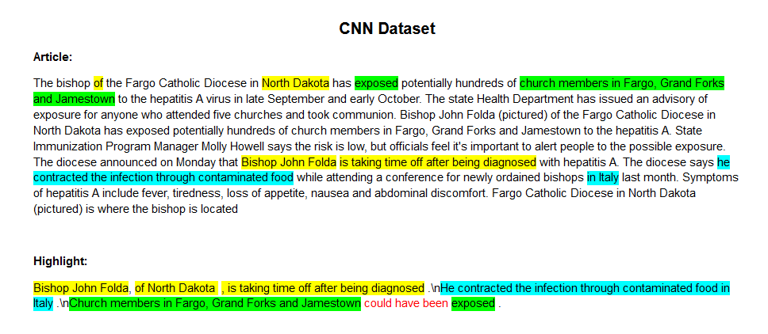
CNN-DailyMail News
It Consists of :-
ID
Articles
Highlights
Dataset Split No. of Articles
Train 287,113
Validation 13,368
Test 11,490

Slide 11
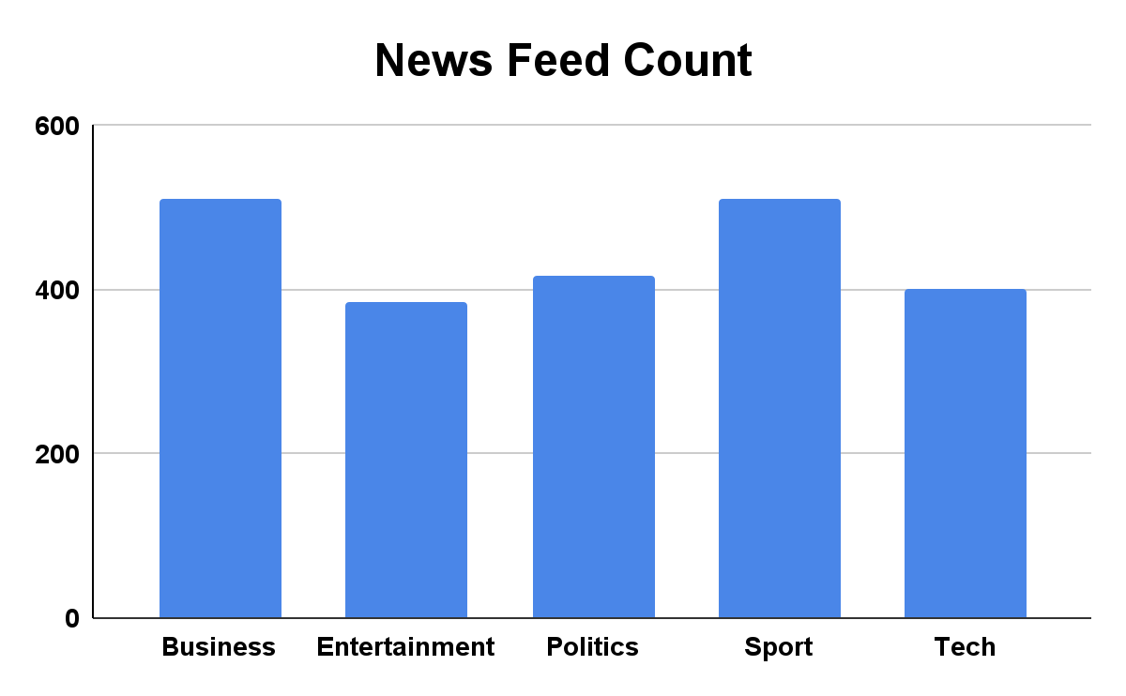
BBC News Summary
2225 documents from the BBC news website corresponding to stories in five topical areas from 2004-2005.
News Categories Distribution :-
Business 510
Entertainment 386
Politics 417
Sport 511
Tech 401

Slide 12
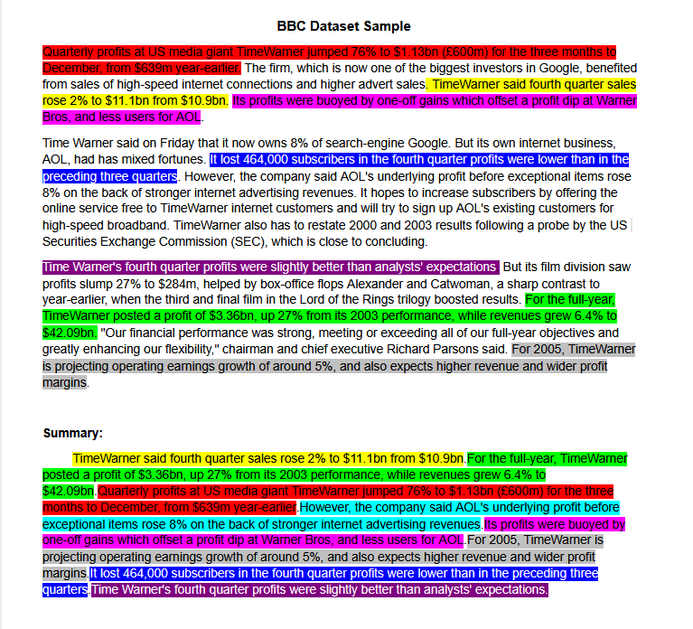
BBC News Summary
Divided into categories, each has related articles and their extractive summarization.

Slide 13

MIND Microsoft News
The Microsoft News Dataset (MIND) was collected from anonymized behavior logs of Microsoft News website.
The data randomly sampled 1 million users.
This dataset is a small version of MIND (MIND-small), by randomly sampling 50,000 users and their behavior logs.
Only training and validation sets are contained in the (MIND-small) dataset.

Slide 14

MIND Microsoft News
The Dataset Contains:
Behaviors.tsv: The click histories and impression logs of users.
News.tsv: The information of news articles.

Slide 15

MIND Behaviours Dataset
The behaviors.tsv file contains the impression logs and users' news click histories.
It has 5 columns divided by the tab symbol:
Impression ID
User ID
Time
History (Ordered by time)
Impressions: (1 for click and 0 for non-click) - List of news displayed with user's click behaviors on them. - The orders of news in a impressions have been shuffled.

Slide 16
Behaviours Dataset Example
Impression ID | 1
User ID | U13740
Time | 11/11/2019 9:05:58 AM
History | N55189 N42782 N34694 N45794 N18445 N63302 N10414 N19347 N31801
Impressions | N55189-1 N35729-0

Slide 17

MIND New Dataset
The news.tsv contains the detailed information of news articles involved in the behaviors.tsv file.
It has 6 columns Separated by the tab symbol:
News ID
Category
SubCategory
Title
Abstract
URL

Slide 18
News Dataset Example
News ID | N24416
Category | news
SubCategory | newsscienceandtechnology
Title | Google to fix 'bug' that uploads free full-quality iPhone pics to Photos
Abstract | Google is about to patch a quirk in Photos that effectively gives iPhone users a free ride. The company told Android Police in a statement that it's planning to fix a Google Photos "bug" that stores iOS photos in their original quality without counting toward Google Drive usage ....
URL | https://assets.msn.com/labs/mind/AAJ4ORa.html

Slide 19
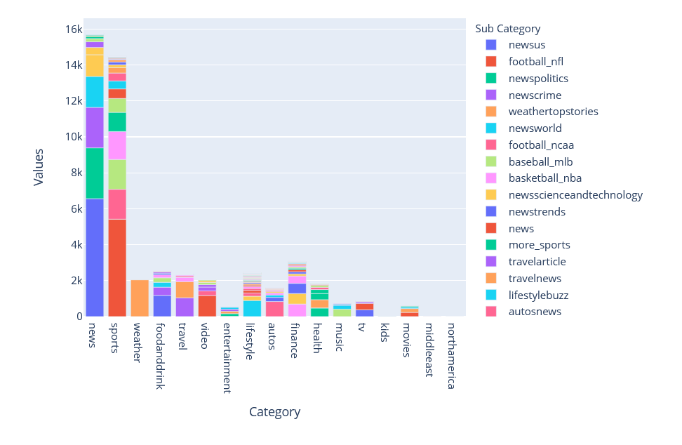
MIND News Dataset Categories

Slide 20
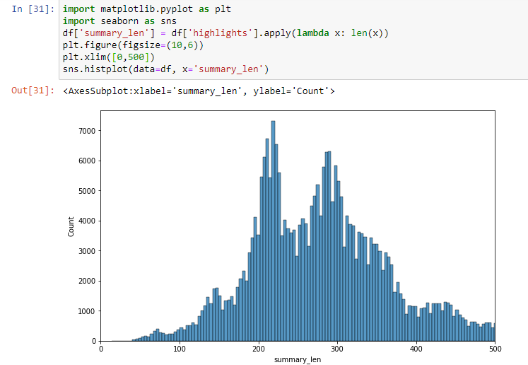
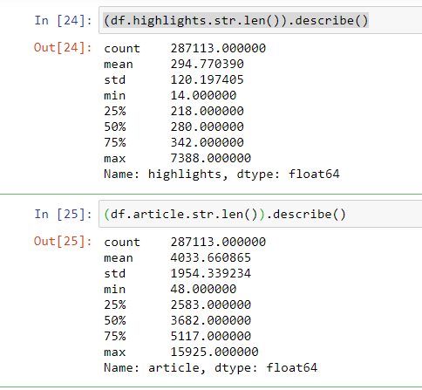
MIND Summary Lengths
Articles Average Length is in the range of 4000 words.
Summaries Average Length is in the range of 300 words.

Slide 21
Comparison
Comparison | CNN News | BBC News | MIND News
Dataset Count | 300K | 2225 | 160k
Categorized | No | Yes | Yes
Summarized | Yes | Yes | Only Abstract
User’s Impressions | No | No | More than 15 million impression logs generated by 1 million users
Pros | Large Dataset with Provided Summary | Summary is Provided | Contains behaviours of users which will help in recommendation
Cons | No Categories or Behaviour dataset | Only 5 Categories and No Behaviour dataset | Need Web Scraping to obtain the articles

Slide 22
Methodology

Slide 23
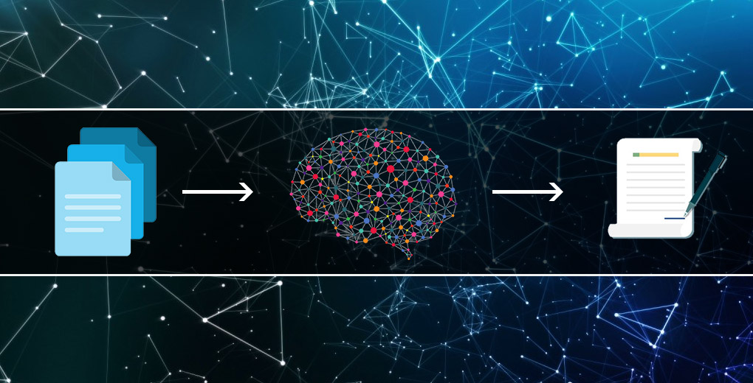
Methodology
Dataset Selection
Data Preprocessing
Text Summarization
Recommendation System
Evaluation and Tuning
Trying advanced techniques

Slide 24

Technologies
Extractive Summarization Techniques such as:
TextRank
LexRank
Abstractive Summarization Techniques such as:
Deep Learning using Encoder and Decoder based models (BART - Transformer Based)
Recommendation Techniques such as:
Rank Based
Matrix Factorization

Slide 25
News Feed Modules

Slide 26

News Feed Modules
We have worked on Two modules concurrently:
News Feed Summarization Module
News Feed Recommendation Module

Slide 27
News Feed Summarization

Slide 28
News Feed Summarization
Model
Evaluation
And
Tuning
News Dataset
Scraping
Articles
Text
Preprocessing
Model Generation
Summarization
Model

Slide 29
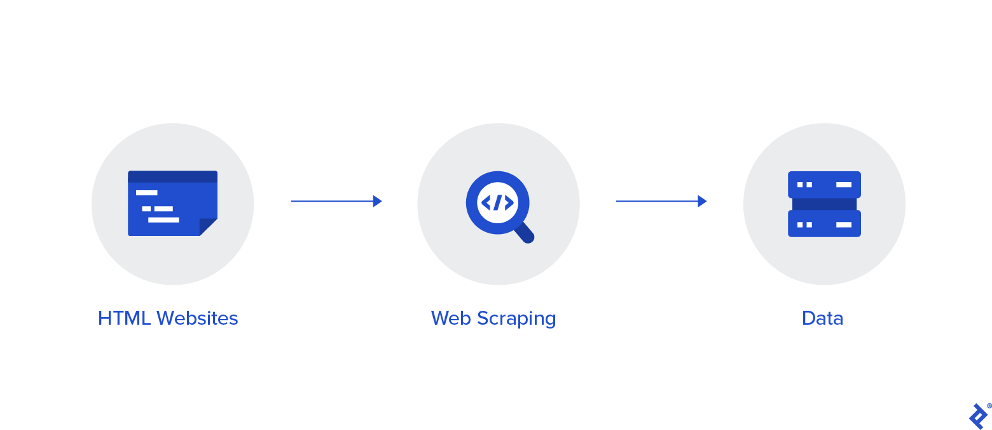
Articles Scraping
Using the URLS in provided in MIND News dataset news:
We scraped the article for each URL using Trafilatura package.
Then used Newspaper3k package for Video Category, because Trafilatura It can't recognize the difference between text and videos which Newspaper3k package could do.

Slide 30
Articles Scraping Packages
Comparison | Trafilatura | Newspaper3k
Pros | Very good with Text only Time Saving | Mainly for News articles Text and image extraction from html Keyword, Summary and Author extraction from text Works in 10+ languages
Cons | It can't recognize the difference between text, videos and images | Time consuming

Slide 31

Text Preprocessing
We applied the following Text preprocessing :
Convert text to lowercase
Contraction mapping
Handling commas (‘s)
Remove HTML tags
Remove any text inside the parenthesis “( )”
Remove punctuations and special characters
Handling stopwords
Text stemming

Slide 32
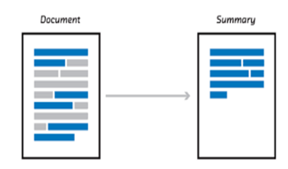
Model Generation
We tackled both Extractive and Abstractive text summarization techniques :
Extractive Text Summarization:
We used a rank based extractive sentence selection algorithm to ensure a pure sentence abstraction.
Abstractive Text Summarization:
We used several novel sentence abstraction techniques which jointly perform sentence compression, fusion, and paraphrasing at the sentence level.

Slide 33
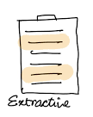
Extractive Text Summary
It is the traditional method developed first.
The main objective is to identify the significant sentences of the text and add them to the summary.
You need to note that the summary obtained contains exact sentences from the original text.
We used two extractive methods:
TextRank
LexRank

Slide 34
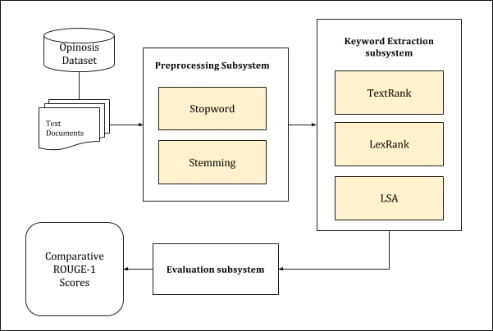
Extractive Summary Pipeline

Slide 35
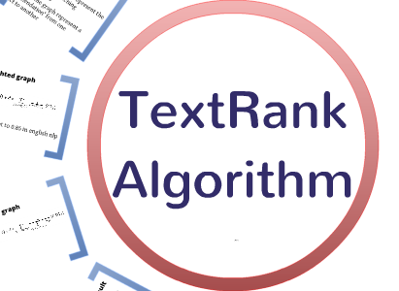
TextRank Extractive Summary
It is based on the concept that words which occur more frequently are significant.
Hence, the sentences containing highly frequent words are important.
TextRank algorithm assigns scores to each sentence in the text.
The top-ranked sentences make it to the summary.

Slide 36
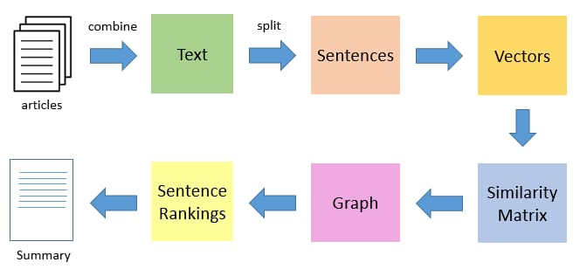
TextRank Extractive Summary
TextRank Model Architecture

Slide 37
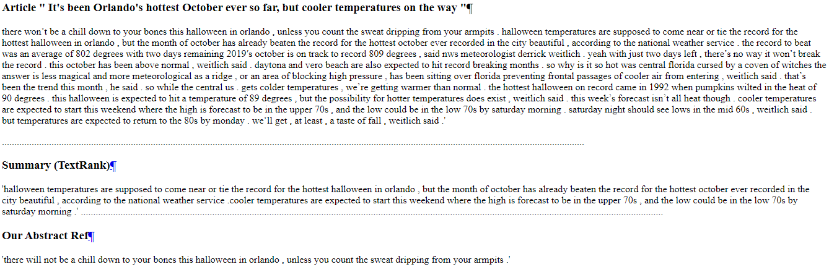
TextRank Extractive Summary
Sample of TextRank Result on MIND Dataset

Slide 38
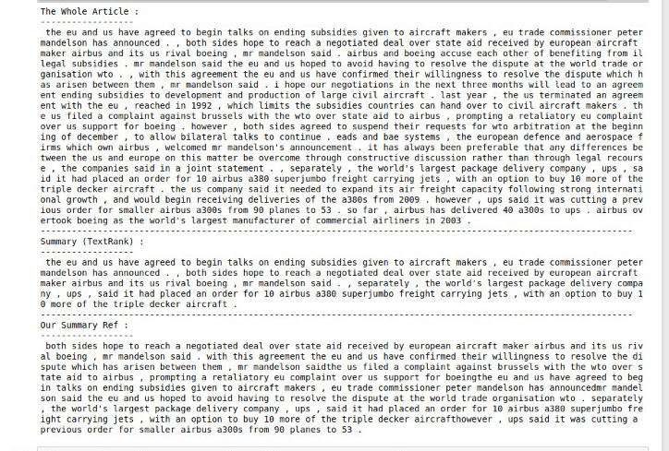
TextRank Extractive Summary
Sample of TextRank Result on BBC Dataset

Slide 39
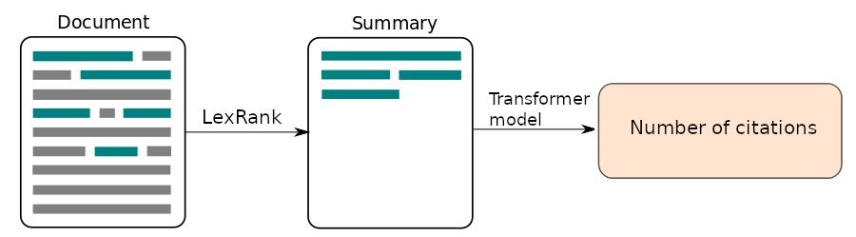
LexRank Extractive Summary
LexRank is based on the concept that sentence which is similar to many other sentences of the text has a high probability of being important.
The approach of LexRank is that a particular sentence is recommended by other similar sentences and hence is ranked higher.
Higher the rank, higher the priority of being included in the summarized text.

Slide 40
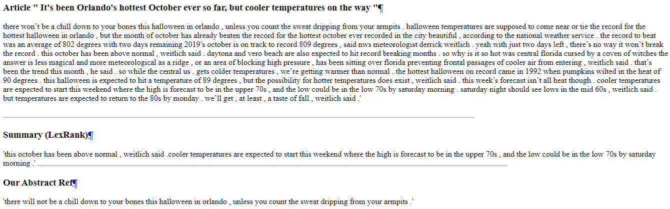
LexRank Extractive Summary
Sample of LexRank Result on MIND

Slide 41
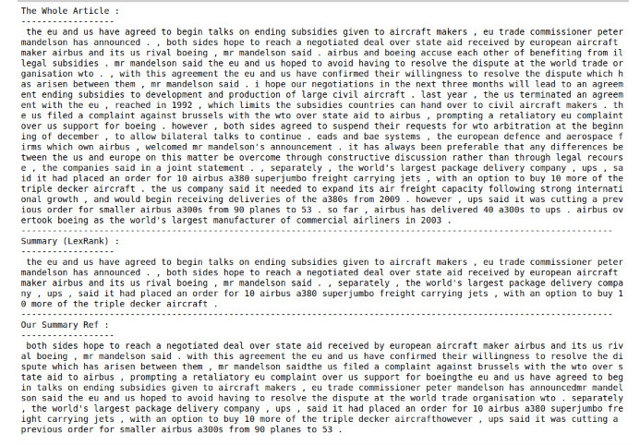
LexRank Extractive Summary
Sample of LexRank Result on BBC Dataset

Slide 42
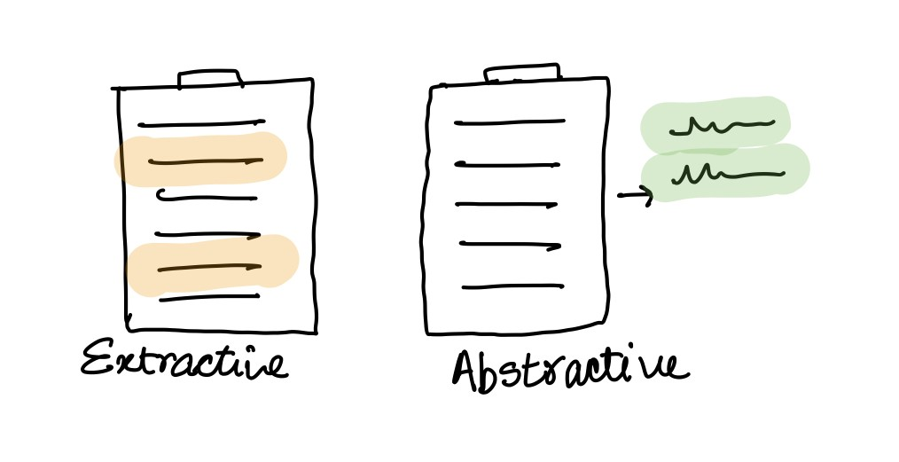
Abstractive Text Summary
It is the new state of art method, which generates new sentences that could best represent the whole text.
This is better than extractive methods where sentences are just selected from original text for the summary.
Some common abstractive techniques are:-
BART
OpenAI
GPT
T5

Slide 43
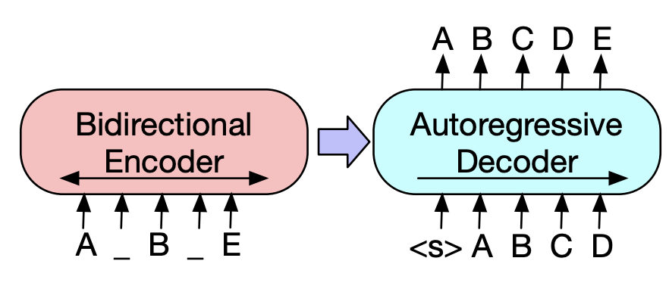
Bart Abstractive Summary
BART stands for Bidirectional and Auto-Regressive Transformer.
BART is a Transformer that combines the Bidirectional Encoder (i.e. BERT like) with an Autoregressive decoder (i.e. GPT like ) into one Seq2Seq model.

Slide 44
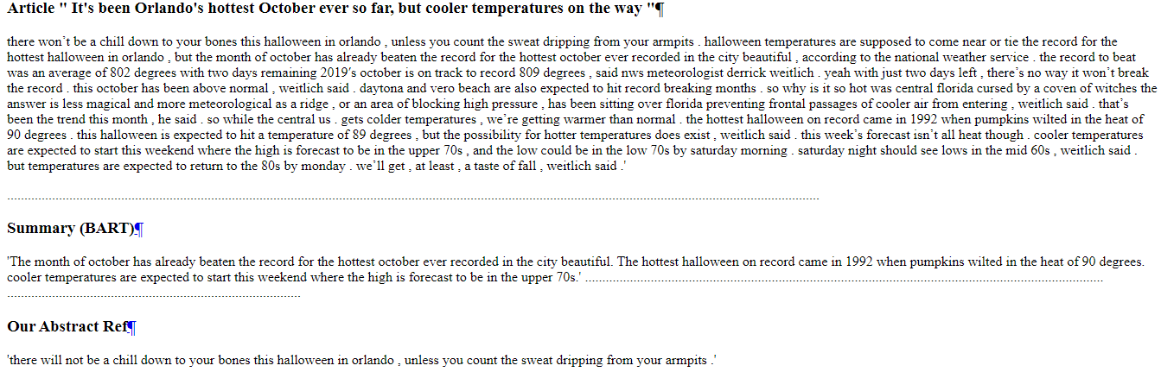
Bart Abstractive Summary
Sample of BART Result on MIND

Slide 45
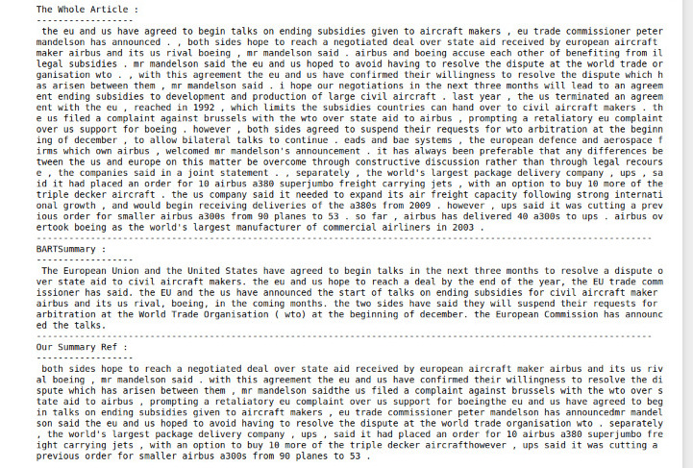
Bart Abstractive Summary
Sample of BART Result on BBC Dataset

Slide 46
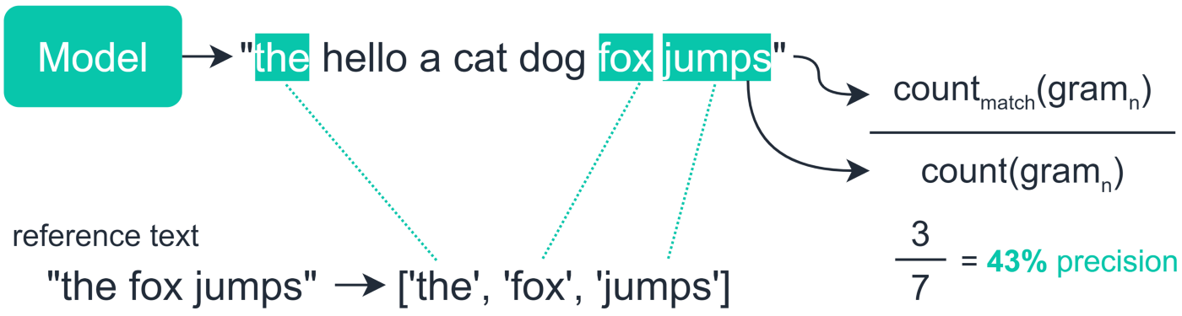
Model Evaluation
We analyse the performance of our model using ROUGE.
It is basically a software package used for evaluating automatic summarization and machine translation software in natural language processing.

Slide 47
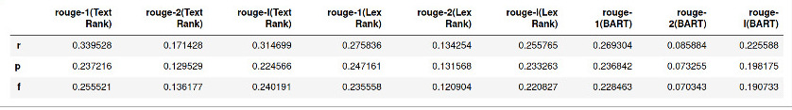
Model Evaluation
In general, TextRank model achieved better results on MIND.
TextRank and LexRank Summaries Evaluation Based on Their Rouge Score on MIND Dataset

Slide 48
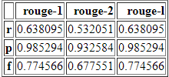
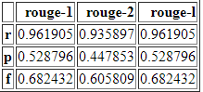
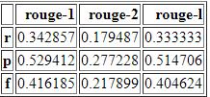
Model Evaluation
TextRank | LexRank | BART
TextRank, LexRank and BART Summaries Evaluation Based on Their Rouge Score on BBC Dataset

Slide 49
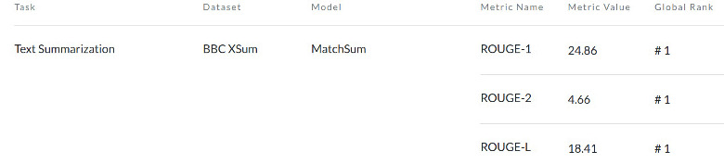
Model Evaluation
BBC Dataset Benchmark Using MatchSum Model

Slide 50
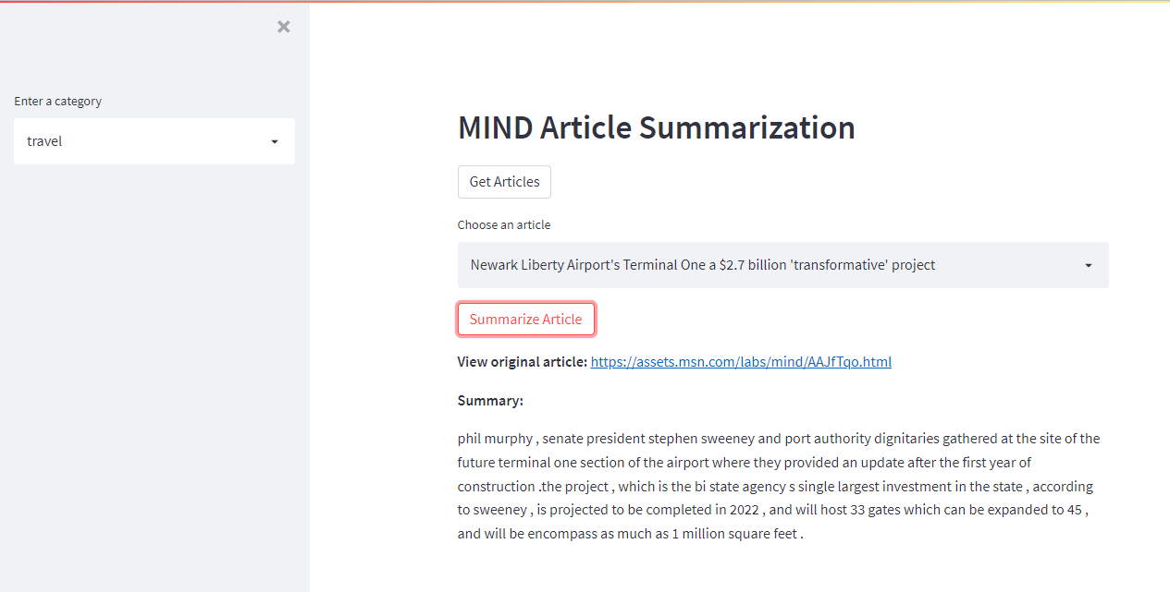
Summarization Model

Slide 51
News Feed Recommendation

Slide 52
News Feed Recommendation
News Dataset
Model Evaluation And Tuning
Behaviours
Preprocessing
Matrix Factorization
Recommender
Model
Behaviors Dataset

Slide 53
Behaviours Dataset Example
Impression ID | 1
User ID | U13740
Time | 11/11/2019 9:05:58 AM
History | N55189 N42782 N34694 N45794 N18445 N63302 N10414 N19347 N31801
Impressions | N55189-1 N35729-0

Slide 54
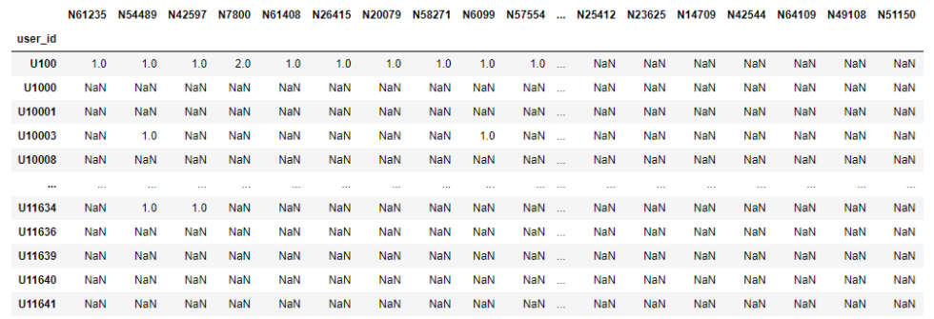
Behaviours PreProcessing

Slide 55
Behaviours PreProcessing
Read Behaviour and News Dataset.
Splitted the user’s interactions, and create dictionary with those interactions.
Collected users’ interactions into single record.
Unpivoted the updated behavior dataframe.
Merged the resulted dataframe with news dataset.

Slide 56
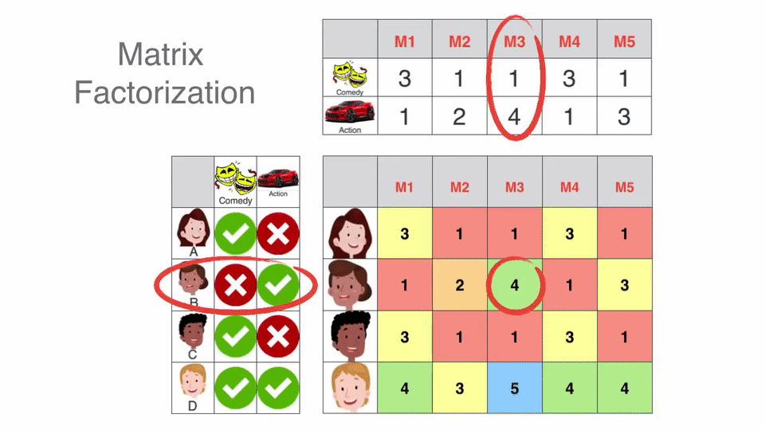
Matrix Factorization

Slide 57

Matrix Factorization
Using Matrix Factorization Library: (Link)
Splitted dataset into training, testing and validation dataset.
Initialize the matrix factorization model and fit the training data on it.
Updated the model’s parameters using Validation dataset.
Tested the model on the testing dataset.
Calculated the RMSE of the testing dataset with the predicted output.

Slide 58

Matrix Factorization
Using Surprise Library: (Link)
Splitted dataset into training and testing dataset using k folds.
Initialized SVD Model.
Looped for each training and testing, fit the model on the train and get the predictions.
Calculated the Precision of the testing dataset with the predicted output.

Slide 59
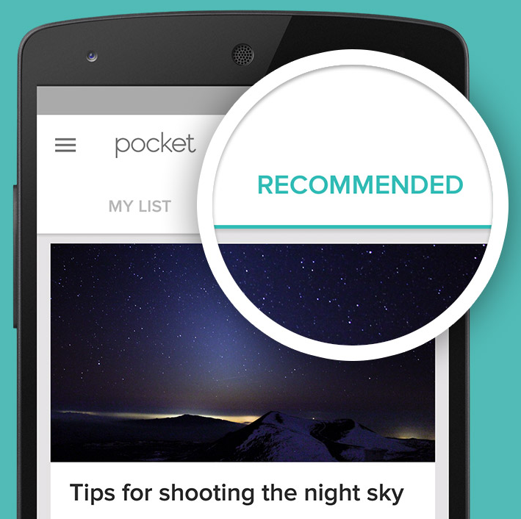
Matrix Factorization
We used 2 approaches:
Using Articles.
Using SubCategories.
Both yield nearly same precision in surprise library so we proceeded with articles dataset.
We also needed our results to provide diversity since many users have only viewed few articles.

Slide 60

Cold Start Problem
As for new users, we don’t have previous interactions history.
This Problem is known as “Cold Start Problem”.
They will be directed to a welcome page with top trending articles among all categories based on number of clicks. (Rank Based)

Slide 61

Model Evaluation
State-of-the-art precision values in similar cases range from 10% up to 30% depending on dataset used.
We used precision@20 as our metric with threshold of 0.15 .
Applying grid search to tune our model boosted precision up to 19% .
After parameter tuning, we ended up using 50 latent features to capture interests of our users and different features for our articles.

Slide 62

Recommendation Model
After training, we saved our model to be ready to generate top 50 predictions for all users in offline mode as Json file.
Using the recommend function which take the User ID and no. of recommendations we want to appear for this user.

Slide 63
Deployment

Slide 64

Deployment
Used FAST API and HTML Templates.
Exposing different APIs to generate predictions for users, by passing User ID as login and display top recommended articles for them.

Slide 65
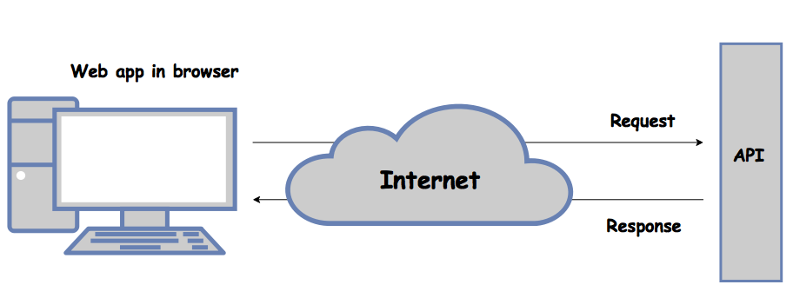
Deployment
Requests and Responses :-
/Home :-
Shows the top trending articles.
/Recommend :-
Shows the recommended articles for the logged-in user if the user was found in dataset, else show top trending articles.
/Category :-
Shows top trending articles in the clicked category.

Slide 66
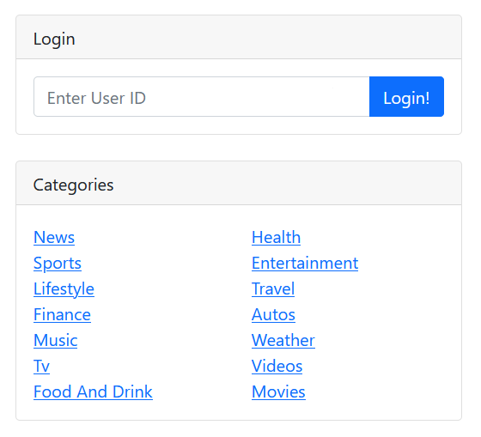
Deployment
Side Widgets :
Login:
Entering user ID to show related user’s predictions.
History:
To show the logged-in user’s previous clicked articles.
Categories:
To show top articles in each category.

Slide 67
Demo

Slide 68
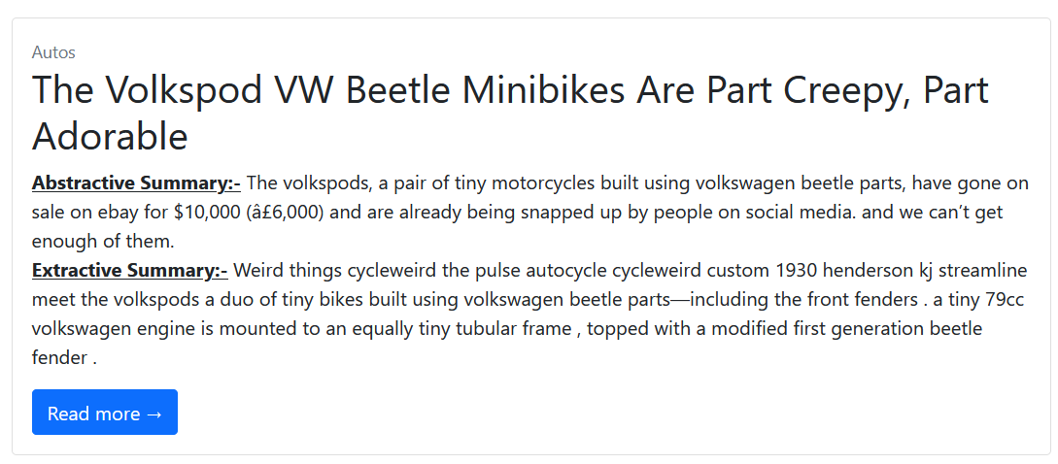
Demo

Slide 69
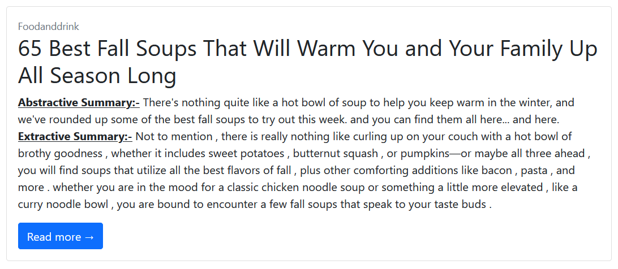
Demo

Slide 70
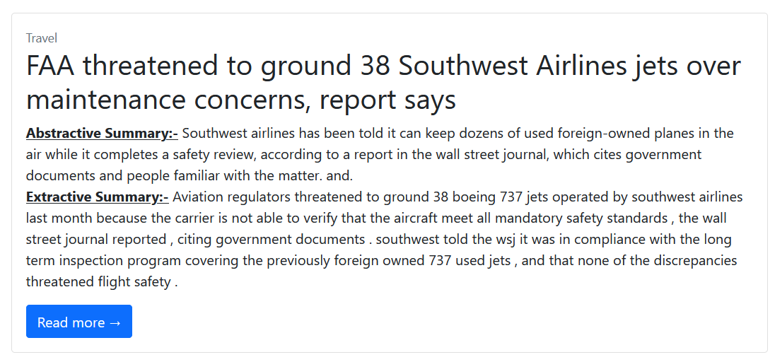
Demo

Slide 71
Demo
News Feed Summarization And Recommendation

Slide 72
Conclusion

Slide 73

Conclusion
Extractive Summary was better as our summary reference was extractive (Abstract Summary).
Recommendation Precision nearly equals 20%.
Results through our testing have proved to provide:
Diversity (Different)
Novelty (New)
Serendipity (Being Interested for user)
Relevance (Connect)

Slide 74
Future Work

Slide 75

Future Work
Adding a login forum with a database where new users can register.
Adding search capabilities to the application where user can search articles by keywords.
Enable user to select his preferences among different subcategories.
Building a more interactive UI.

Slide 76
Appendix: Github

Slide 77
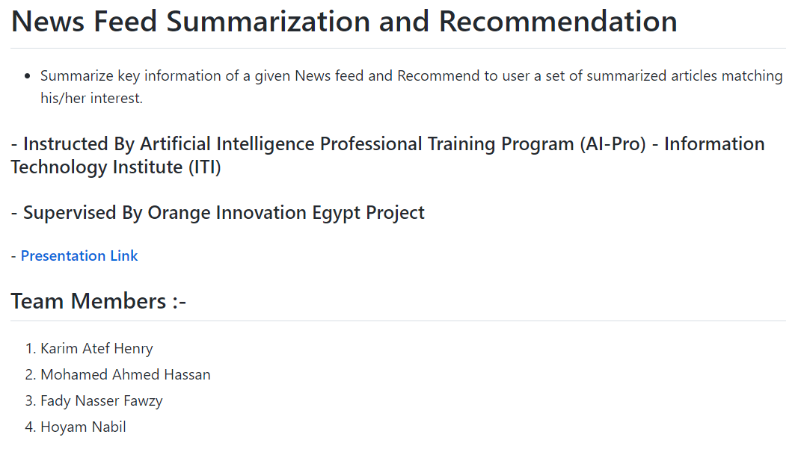
Github ReadMe

Slide 78
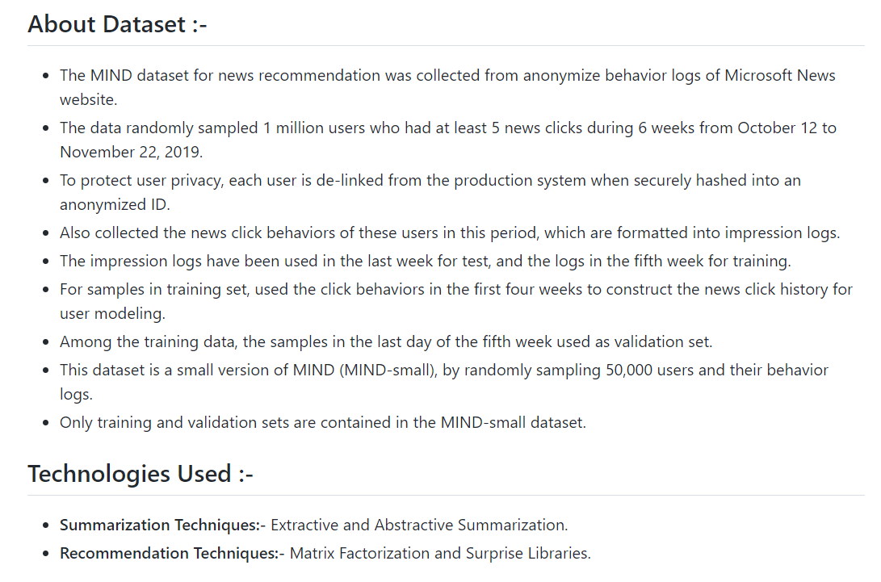
Github ReadMe

Slide 79
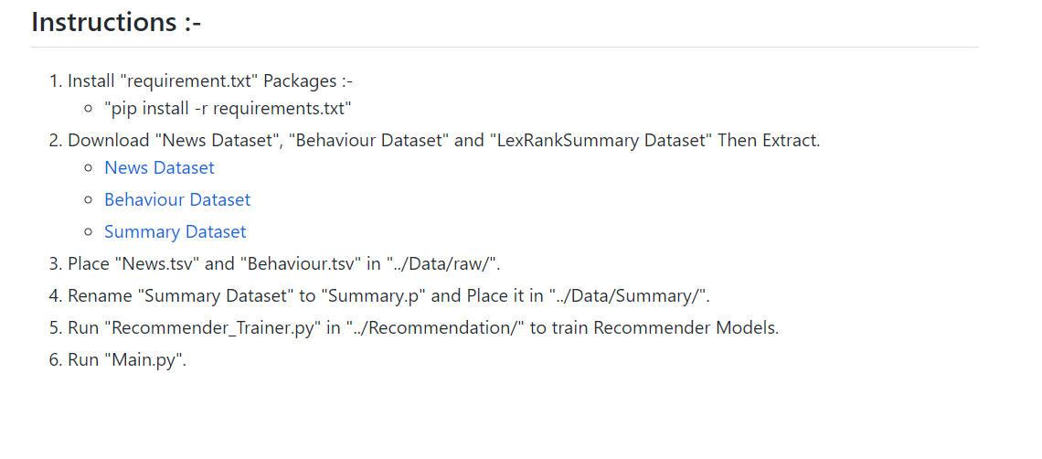
Github ReadMe

Slide 80
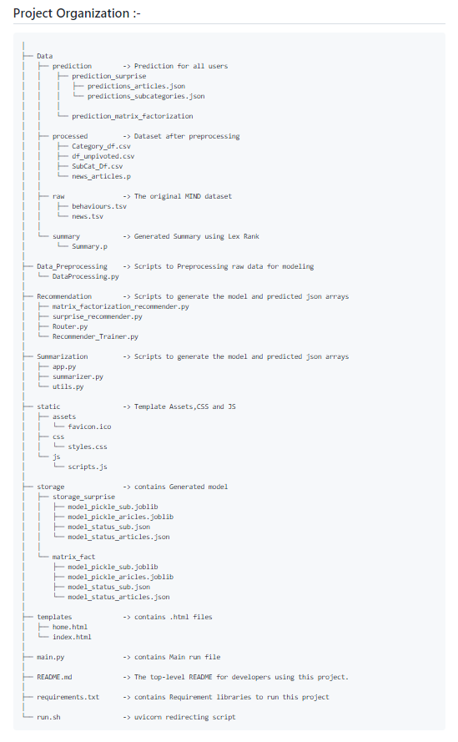
Github ReadMe

Slide 81
Github Link
Github.com/New_feed_Summarization_Recommendation

Slide 82


